Slide 1
Matrix Multiplication on Map-Reduce Framework
Group#23: Rajesh Kapa, Venu Babu kolla, Manideep Tatineni, Raghu vital gummadi.

Slide 2
Usecase: Matrices are Large
Map- reduce program to multiple two large matrices.
Algorithm:
Mappers read input data.
Every reducer processes one block of the resulted matrix.

Slide 3
Input:
4x4 matrix
0 18 20 16 14
1 17 12 11 19
2 10 17 11 19
3 14 17 20 10
Data stored in a file on Hadoop and Each matrix is stored in a separate file.
Line number must be appended to the beginning of each line.

Slide 4
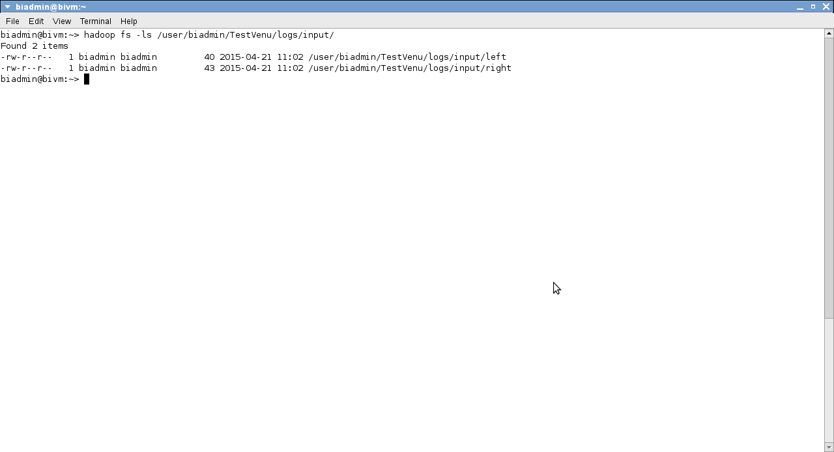
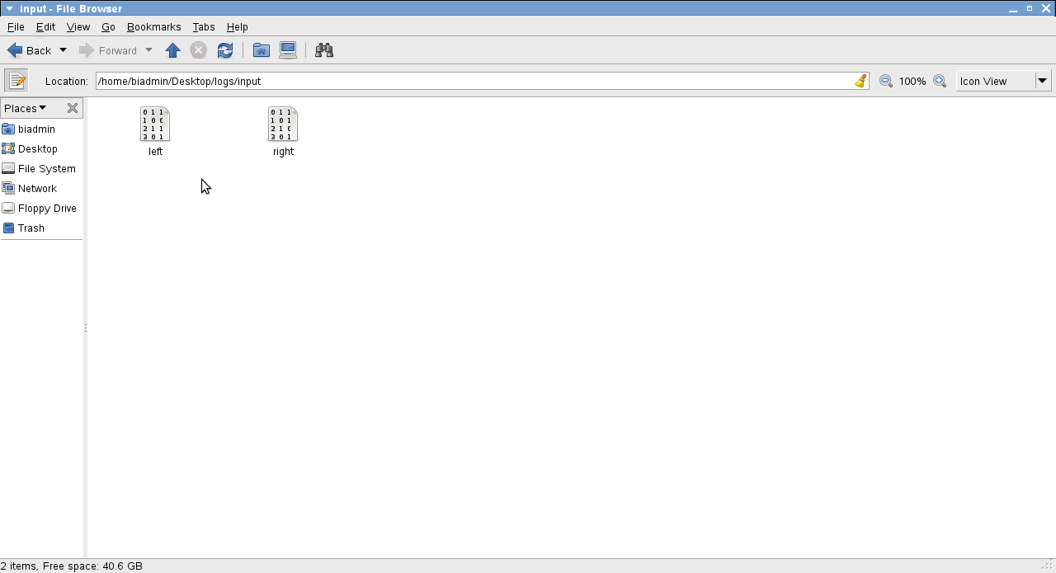

Slide 5
Execution: IBM BigInsights
> hadoop jar MatrixMultiplication.jar main.MatrixMul input output 4 2
Results will be placed in "output" folder on HDFS.
4: all matrices are 4x4
2: every partitioned block is of size 2x2

Slide 6
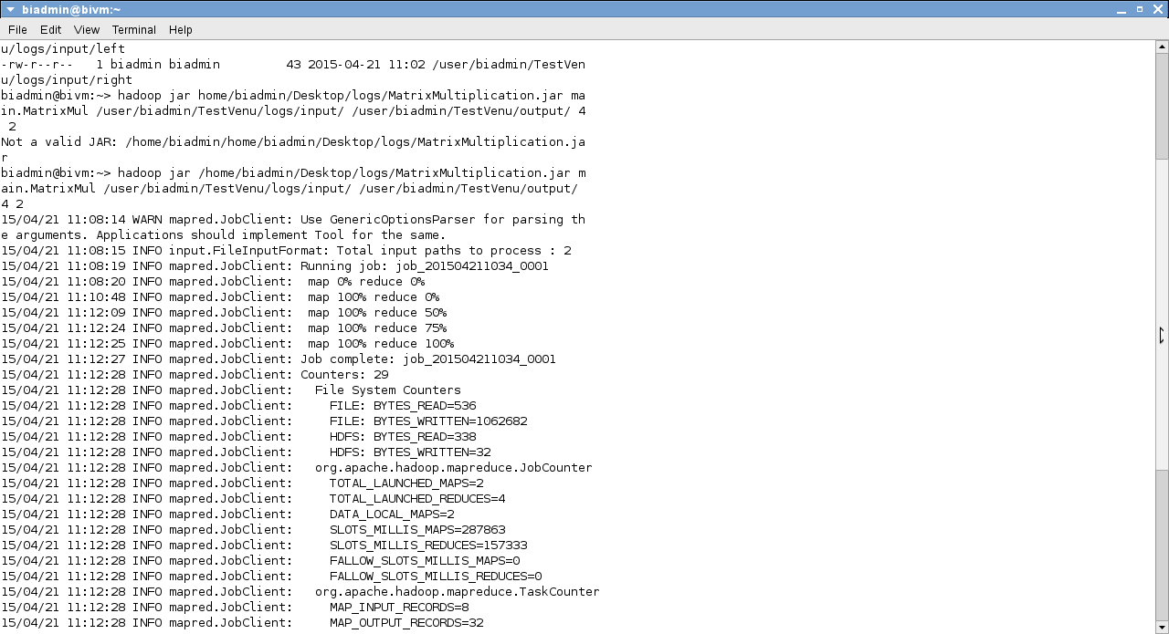
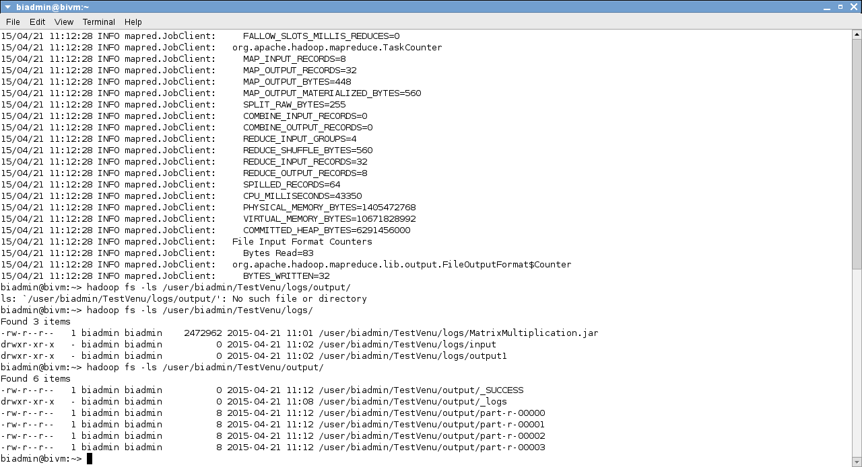

Slide 7
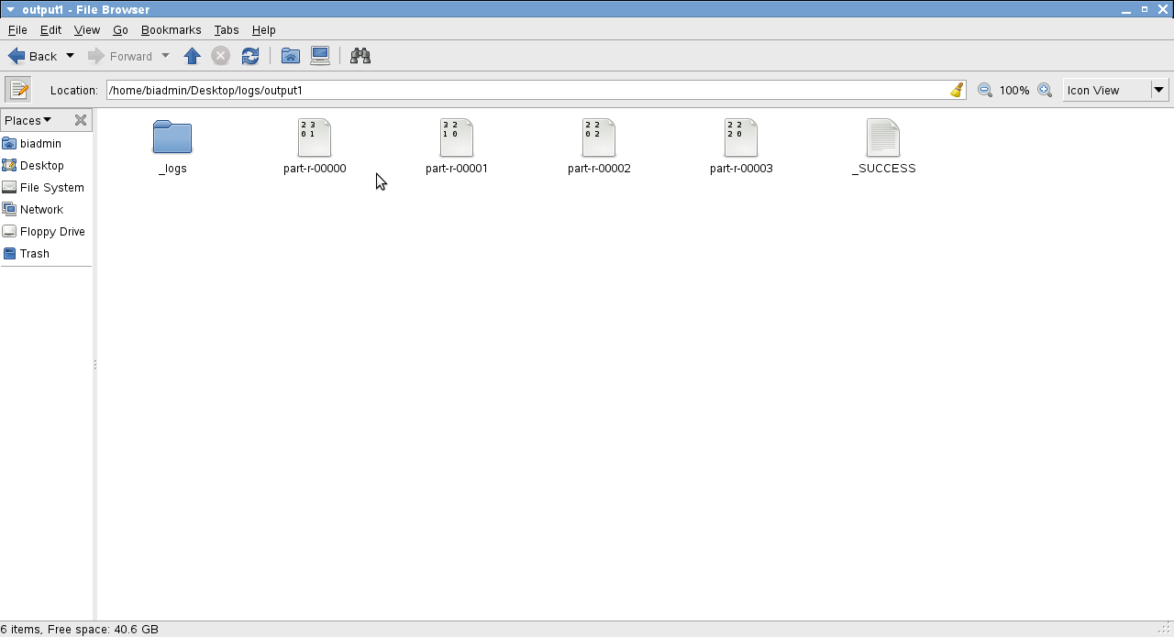
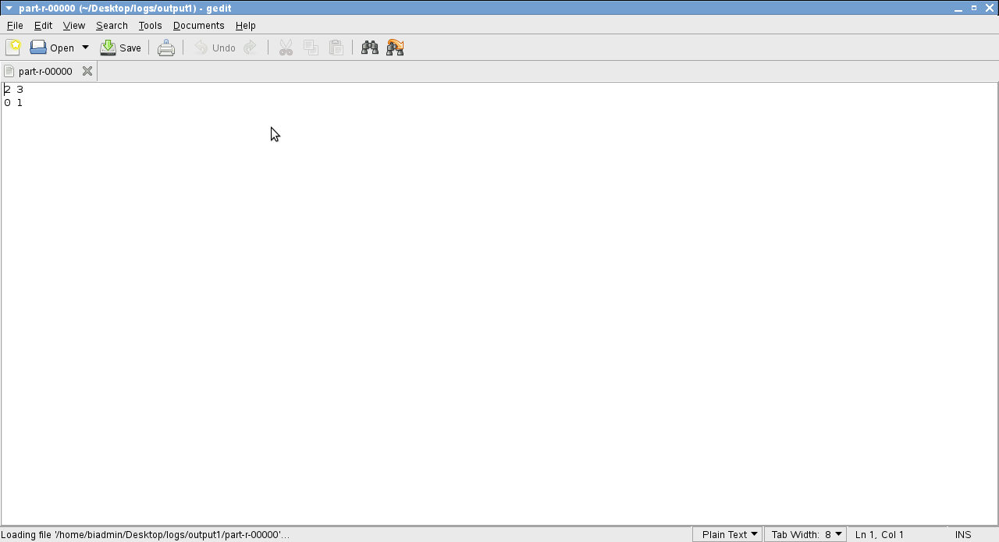
Output:
we multiply two 4x4 matrices, in many 2x2 blocks. So, that the resulted C matrix has 4 blocks.

Slide 8


